Slide 1



LOG ORGANIZATION AND monitoring
G.L Bajaj Institute
of
Technology & Management
Gr. Noida
Presented by:
Avinash Kumar
Prashant Kumar
Sumit Kumar
Raunak Kumar
Organise it, monitor it, cross-check it
All at one place with complete text search

Slide 2
About
Storing log data from multiple sources in a central location
Enforcing retention policies on your logs so they are available for a specific time period
Easily searching inside the logs for important information
Generating alerts based on metrics you define on the logs
Sharing your dashboard and log information with others simply and quickly
Low costs and increased storage and backup for historical data
Setting up security alerts and granting login access to particular users without granting server root access
Centralized Log Management (CLM) is a type of logging solution system that consolidates all of your log data and pushes it to one central, accessible, and easy-to-use interface. Centralized logging is designed to make your life easier..

Slide 3





The Problem
Trouble Shooting
Management
Loss of Data
Value
Security
Logs are indispensable when it comes to pinpointing problems and determining their causes. They’ll let you identify issues based on hard data, not guesswork.
Once you’re collecting data, log review and analysis should become part of your daily or weekly regimen, depending on the size of your environment.
A centralized logging system removes the individual server from the equation. If the server you’re trying to troubleshoot is down, local log files won’t be accessible, rendering you blind.
Once you’ve accumulated enough data, you can perform a lot of different types of analysis on it to better understand your network and your users.
By centrally logging user activity, you can analyze for activity trends and notice any unusual behavior.

Slide 4
solution
Log Collecting/Archiving
Log Normalization
Log Intelligence/Forensics and Monitoring
Making a collective processes and policies used to administer and facilitate the generation, transmission, analysis, storage, archiving and ultimate disposal of the large volumes of log data created within an information system.

Slide 5


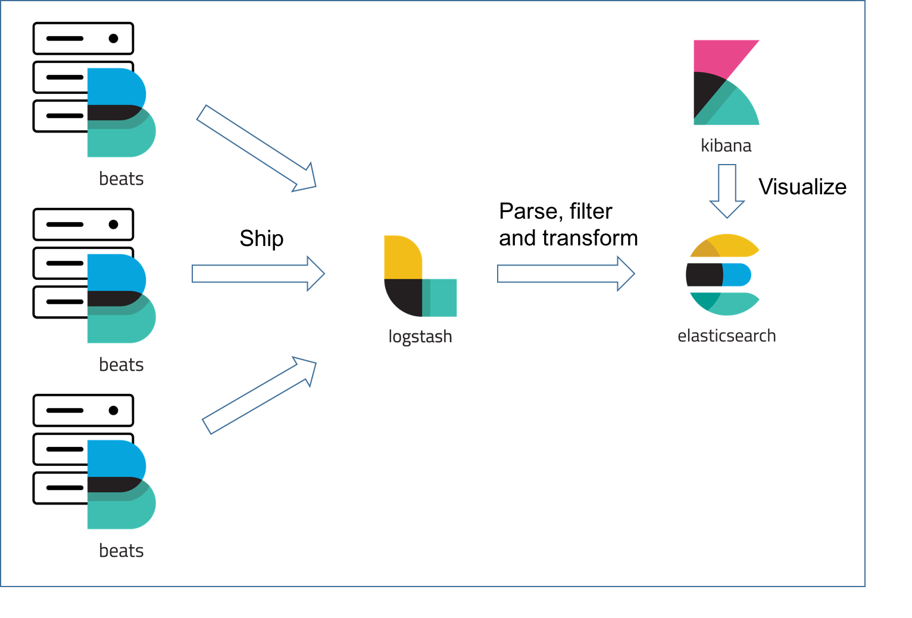
Beats
Logstash
Beats is the platform for single-purpose data shippers.
Logstash is a server‑side data processing pipeline that ingests data from multiple sources
Technology
The ELK Stack is a collection of three open-source products — beats, Elasticsearch, Logstash, and Kibana — from Elastic. Elasticsearch is a NoSQL database that is based on the Lucene search engine. ... Kibana is a visualization layer that works on top of Elasticsearch.
Elastic Search
Kibana
ElasticSearch is an open source, RESTful search engine built on top of Apache Lucene
It provides visualization capabilities on top of the content indexed on an Elasticsearch ...

Slide 6
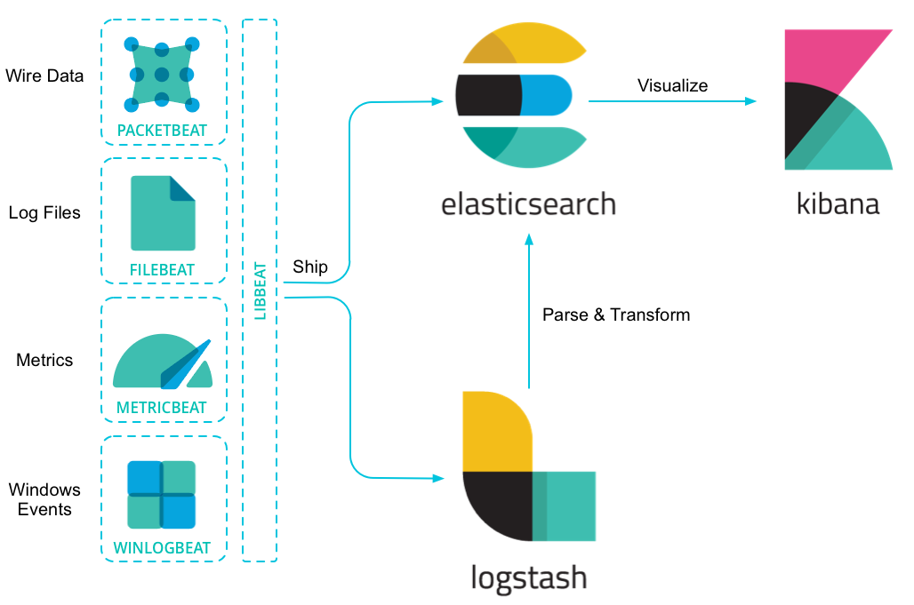
Beats
Lightweight Data Shippers
Beats is the platform for single-purpose data shippers. They send data from hundreds or thousands of machines and systems to Logstash or Elasticsearch.
Ship from the Source. Plain and Simple.
Beats are great for gathering data. They sit on your servers, with your containers, or deploy as functions — and then centralize data in Elasticsearch. And if you want more processing muscle, Beats can also ship to Logstash for transformation and parsing.
Accelerate the Data-to-Visualize Experience with
Modules Filebeat and Metricbeat include internal modules that simplify collecting, parsing, and visualizing common log formats such as, NGINX and Apache and system metrics such as Redis and Docker. Run a single command and explore away.

Slide 7
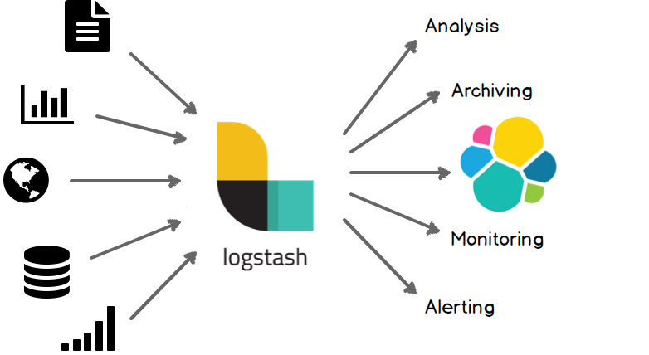
Logstash
Ingest Data of All Shapes, Sizes, and Sources
Data is often scattered or siloed across many systems in many formats. Logstash supports a variety of inputs that pull in events from a multitude of common sources, all at the same time. Easily ingest from your logs, metrics, web applications, data stores, and various AWS services, all in continuous, streaming fashion.
Parse & Transform Your Data On the Fly
Derive structure from unstructured data with grok
Decipher geo coordinates from IP addresses
Anonymize PII data, exclude sensitive fields completely
Ease overall processing independent of the data source, format, or schema.
Choose Your Stash, Transport Your Data
While Elasticsearch is our go-to output that opens up a world of search and analytics possibilities, it’s not the only one available.
Logstash has a variety of outputs that let you route data where you want, giving you the flexibility to unlock a slew of downstream use cases.

Slide 8
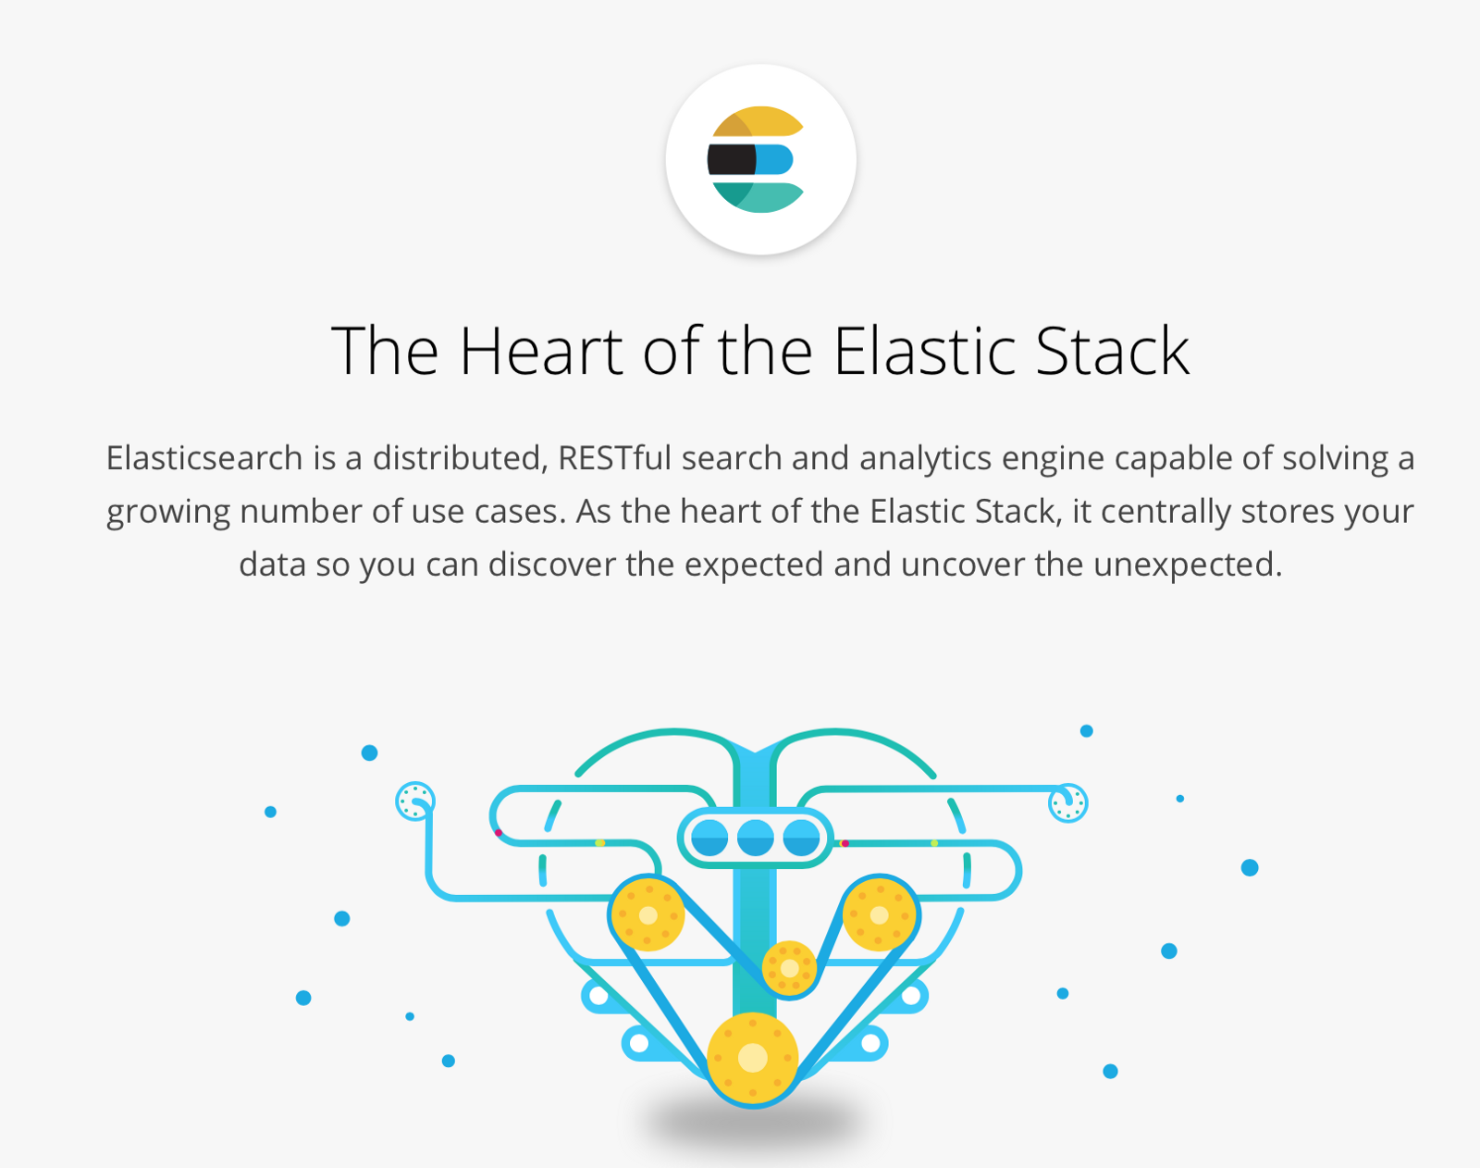
Elastic search
The Heart of the Elastic Stack
Elasticsearch is a distributed, RESTful search and analytics engine capable of solving a growing number of use cases. As the heart of the Elastic Stack, it centrally stores your data so you can discover the expected and uncover the unexpected.
Query
Analyze
Fast
Scalability
Resiliency
Flexibility
Operational Happiness

Slide 9
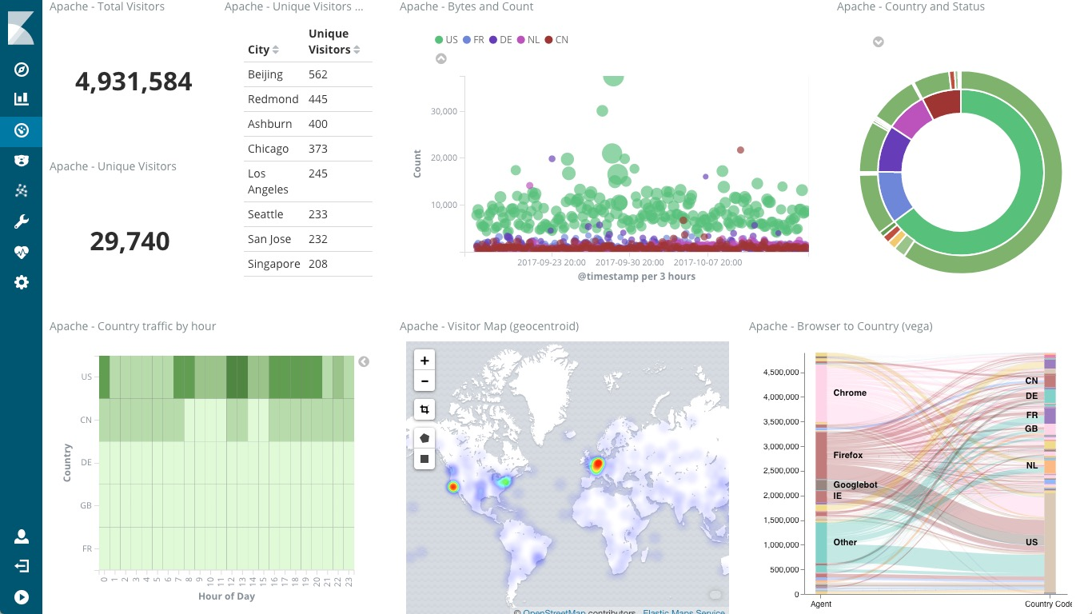
Kibana
Kibana lets you visualize your Elasticsearch data and navigate the Elastic Stack, so you can do anything from learning why you're getting paged at 2:00 a.m. to understanding the impact rain might have on your quarterly numbers.
Put Geo Data on Any Map
Time Series Is Also on the Menu
Time Series Is Also on the Menu
Explore Anomalies with Machine Learning
Get Creative with Canvas
Bring Everyone in on the Goodness.

Slide 10
ARCHITECTURE

Slide 11
EXAMPLE OF LOG FILE
Timestamp: 3/4/2016 12:11:42 PM Title:xyzzz() Message: Product ZX8364 has been removed from cart StackTrace: at System.Boolean.Parse(String value)Exception rethrown at [0]: at System.Runtime.Remoting.Proxies.RealProxy.HandleReturnMessage(IMessage reqMsg, IMessage retMsg) at System.Runtime.Remoting.Proxies.RealProxy.PrivateInvoke(MessageData& msgData, Int32 type).... Machine: USNGDY22
<85>1 2010-12-17T15:12:04.287-06:00 cabig-h1 OHT 521 IHE+RFC-3881 -
<?xml version="1.0" encoding="UTF-8"?>
<AuditMessage>
<EventIdentification EventDateTime="2010-12-17T15:12:04.287-06:00"
EventOutcomeIndicator="0"
EventActionCode="E">
<EventID code="110114" codeSystemName="DCM"
displayName="UserAuthenticated" />
<EventTypeCode code="110122" codeSystemName="DCM"
displayName="Login" />
</EventIdentification>
<ActiveParticipant UserID="fe80::5999:d1ef:63de:a8bb%11"
UserIsRequestor="true"
NetworkAccessPointTypeCode="1"
NetworkAccessPointID="125.20.175.12">
<RoleIDCode code="110150" codeSystemName="DCM"
displayName="Application" />
</ActiveParticipant>
<ActiveParticipant UserID="farley.granger@wb.com" UserIsRequestor="true"/>
<AuditSourceIdentification AuditEnterpriseSiteID="End User"
AuditSourceID="farley.granger@wb.com">
<AuditSourceTypeCode code="1" />
</AuditSourceIdentification>
</AuditMessage>

Slide 12
AFTER PARSING
{"index":{"_index":"shakespeare","_id":31600}}
{"type":"line","line_id":31601,"play_name":"Cymbeline","speech_number":12,"line_number":"5.3.92","speaker":"POSTHUMUS LEONATUS","text_entry":"But end it by some means for Imogen."}
{"index":{"_index":"shakespeare","_id":31601}}
{"type":"line","line_id":31602,"play_name":"Cymbeline","speech_number":12,"line_number":"","speaker":"POSTHUMUS LEONATUS","text_entry":"Enter two British Captains and Soldiers"}
{"index":{"_index":"shakespeare","_id":31602}}
{"type":"line","line_id":31603,"play_name":"Cymbeline","speech_number":13,"line_number":"5.3.93","speaker":"First Captain","text_entry":"Great Jupiter be praised! Lucius is taken."}
{"index":{"_index":"shakespeare","_id":31603}}
{"type":"line","line_id":31604,"play_name":"Cymbeline","speech_number":13,"line_number":"5.3.94","speaker":"First Captain","text_entry":"Tis thought the old man and his sons were angels."}
{"index":{"_index":"shakespeare","_id":31604}}
{"type":"line","line_id":31605,"play_name":"Cymbeline","speech_number":14,"line_number":"5.3.95","speaker":"Second Captain","text_entry":"There was a fourth man, in a silly habit,"}
{"index":{"_index":"shakespeare","_id":31605}}
{"type":"line","line_id":31606,"play_name":"Cymbeline","speech_number":14,"line_number":"5.3.96","speaker":"Second Captain","text_entry":"That gave the affront with them."}

Slide 13
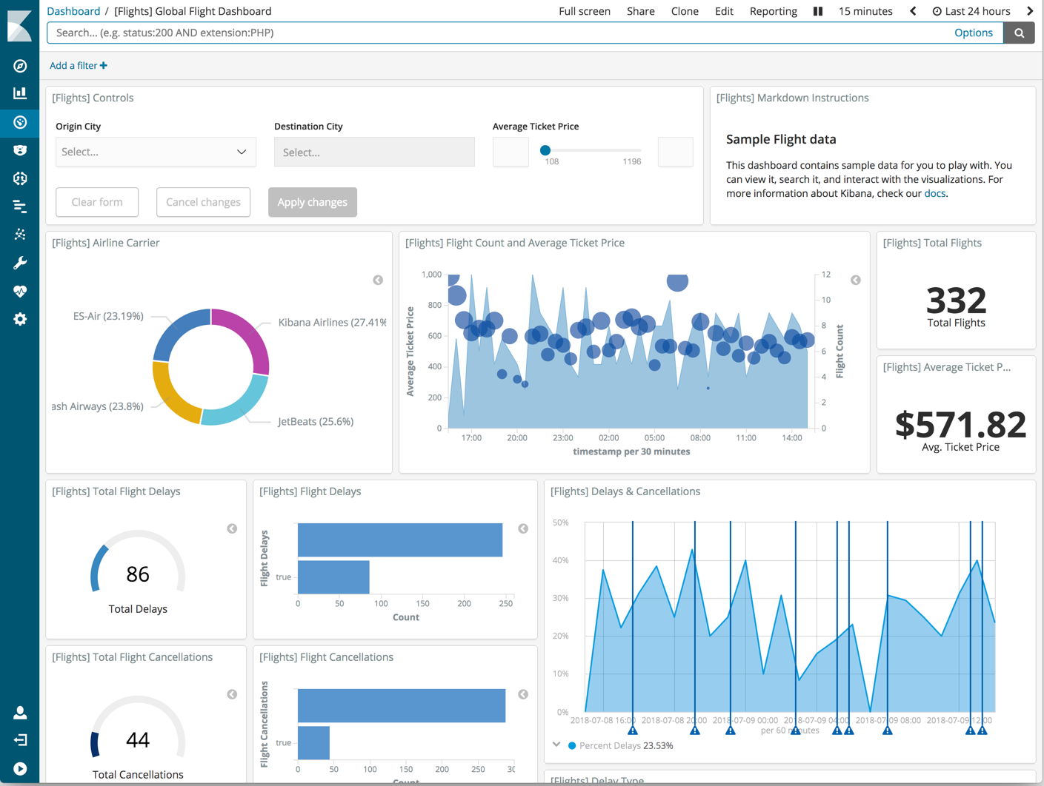
DASHBOARD

Slide 14




The Challenges
Managing Logs can be Expensive
Logs can consume a lot of disk space
Volume of information is huge
No one size fits all.

Slide 15
Achievement
Develop logging Policy
Determine what information is relevant to you.
What devices are important?
What events are important?
Don’t forget to turn on logging!
Timing of events, e.g. user logons in morning.
What reports you and the business want/need?
Group servers into zones based on their function or criticality and prioritize events accordingly.
Baseline your systems & network.
Determine how your network normally behaves.
Repeat at regular intervals
Secure log files on all devices.
Encrypt logs
Ensure all devices use same time source.
If using more than one time zone use UTC.
Use NTP protocol from a secure source to synchronize time.

Slide 16
Achievement
Centralize log collection
Dedicated server to collect all logs.
Be careful of network traffic volumes.
Be aware of limitations of server to process number of events.
Configure all devices send logs to central log server.
Make sure central server is secure.
Secure transmission of logs.
e.g. Syslog uses UDP by default. Consider using IPSec or next generation Syslog (Syslog-NG) Determine what information is relevant to you.
Normalize the data
All events such as Windows, Syslog, SNMP etc. should be normalised into same format.
Review the Logs
Ensure logs are regularly reviewed.
Manually
Automatically
Scripts
Commercial Tools
Freeware Tools.

Slide 17
Important Windows Events
Local Logon Attempt Failures
Event IDs 529, 530, 531, 532, 533, 534 & 537.
Domain Logon Account Failures
Event IDs 675, 677
Account Misuse
Event IDs 530, 531, 532, 533
Account lockout
Event ID 539
Terminal Services
Event IDs 682, 683
Modification of Security Groups
Event IDs 632, 633, 636, 637
Modification of Security Log
Event IDs 612, 517

Slide 18
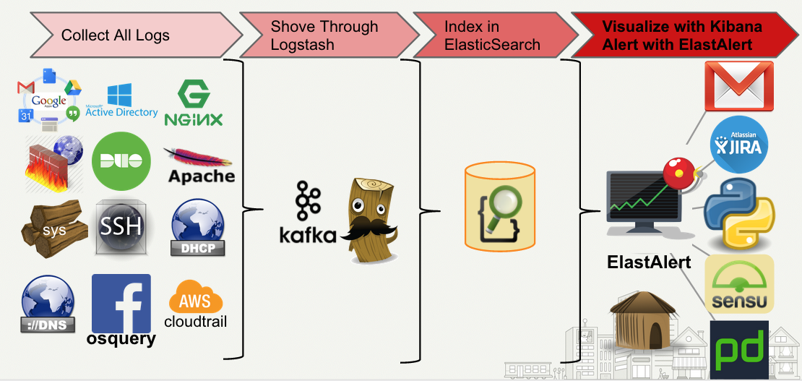
What’s Next??

Slide 19
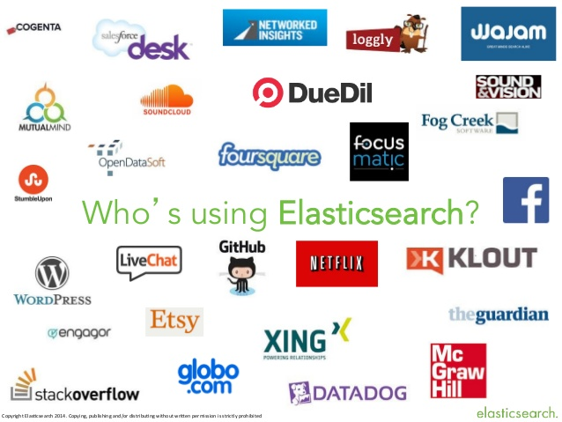
WHO USE ELASTICSEARCH??

Slide 20

Bibliography
www.elastic.co
www.logz.io
www.Wikipedia.com

Slide 21


Questions???????

Slide 22
Thank You

